Slide 1
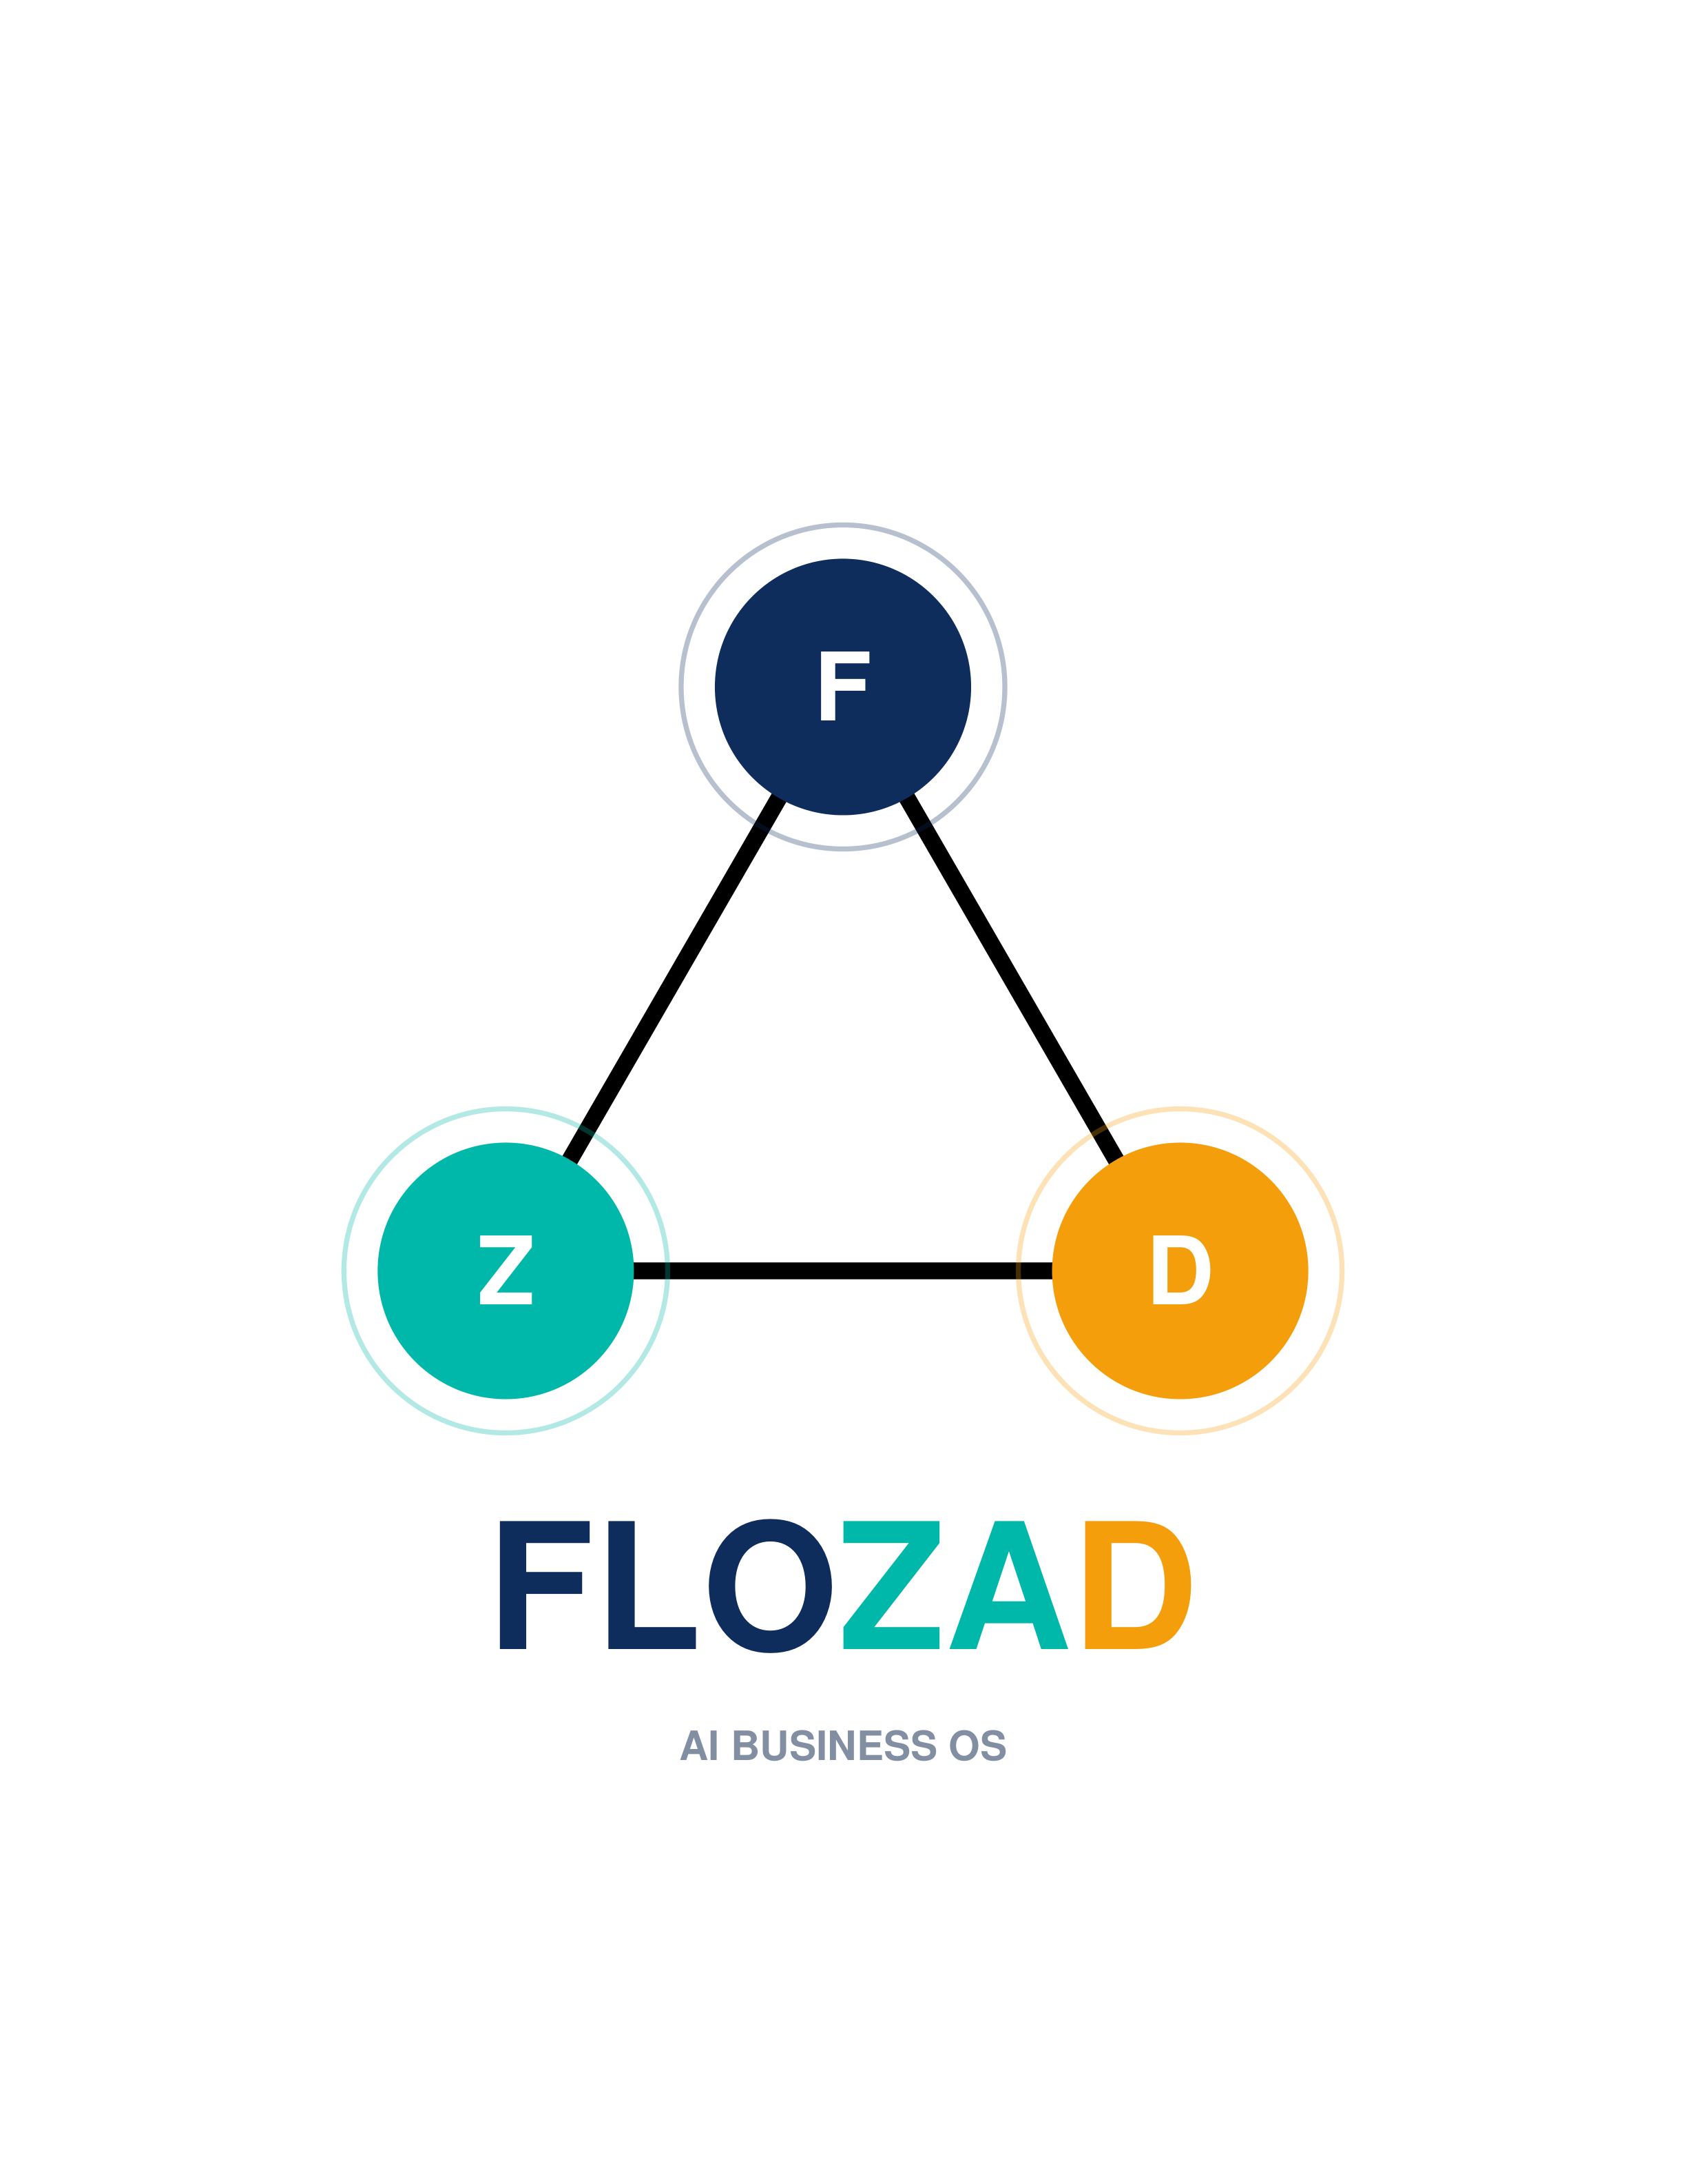
CONNECTED. ENGINEERED. DELIVERED.
FLOZAD & FLOZAD HR
Enterprise Software Engineering & Next-Gen Philippine HRIS Platform
Founding Partners: Ricky Jay-R Flores (CEO) | Joeby Zaldivar (CTO) | Irish David (CBO)
Website: www.flozad.com | Contact: contact@flozad.com

Slide 2
COMPANY ORIGIN
Company Origin — The Triangle of Strength
The FLOZAD logo is a triangle — the strongest shape in engineering — held up by three nodes representing the surnames of our founders: FLO (#0F2D5C), ZA (#00B8A9), and D (#F59E0B).
FLO (Flores)
ZA (Zaldivar)
D (David)
Ricky Jay-R Flores
Chief Executive Officer (Connected)
FLO — Flores (CEO). Connected. Sets strategic vision, opens enterprise commercial doors, and brings capital & networks.
Joeby Zaldivar
Chief Technology Officer (Engineered)
ZA — Zaldivar (CTO). Engineered. 17+ years software architect. Technical core building custom AI, FLOZAD ERP, and FLOZAD HR.
Irish David
Chief Business Officer (Delivered)
D — David (CBO). Delivered. The voice of FLOZAD. Drives growth, manages partnerships, and ensures solutions fit operations.
| Confidential Pitch Deck | Slide 2 of 12

Slide 3
01 / OUR APPROACH
Your workflow is the blueprint.
We do not start with a demo. We start by understanding the work behind the numbers, then engineer the clearest AI-powered path forward.
01
Listen first
We sit with your people to map the real workflow — not the one on the org chart. Process before product, always.
02
Engineer with excellence
We deploy AI agents and custom systems built process-first, so the intelligence fits your operation, not the other way around.
03
Stay accountable
From the first handshake to final handover — and every iteration after — the founders stay close and the system keeps improving.
| Confidential Pitch Deck | Slide 3 of 12

Slide 4
SERVICE ECOSYSTEM
FLOZAD Enterprise Software Capabilities
Agentic AI Solutions
Custom autonomous AI agents, workflow automation, LLM integration, and intelligent document processing tailored for enterprise systems.
Process-First Custom Software
Tailor-made software built around your exact business workflows — eliminating inefficiencies through deep workflow mapping before coding.
FLOZAD HR (Powered by HirayaHR)
HRIS & Statutory Payroll platform built with Laravel + Inertia.js + Vue.js, deployable on your own domain and dedicated infrastructure.
FLOZAD ERP Platform
Integrated enterprise resource planning covering inventory tracking, warehouse logistics, procurement, sales, and financial accounting.
Dedicated Cloud & Infrastructure
Dedicated cloud server deployment, client-owned domain integration, custom security policy, and high-availability server setup.
IT Consultation & Data Analytics
Strategic technology advisory, enterprise system integration, custom BI dashboards, and data analytics pipelines.
| Confidential Pitch Deck | Slide 4 of 12

Slide 5
PRODUCT SPOTLIGHT
Introducing FLOZAD HR (Powered by HirayaHR)
NEXT-GEN ENTERPRISE HRIS & PAYROLL
FLOZAD HR is built on a modern high-performance tech stack — Laravel + Inertia.js + Vue.js — giving your enterprise desktop-like UI speed with robust PHP backend reliability.
CLIENT INFRASTRUCTURE & DOMAIN FREEDOM
Unlike rigid SaaS platforms, FLOZAD HR is fully deployable on your own dedicated cloud server or on-premise infrastructure under your company's custom domain (e.g. hr.yourcompany.com).
• Laravel + Inertia.js + Vue.js Stack
Modern reactive frontend paired with enterprise Laravel framework for speed, security, and developer clarity.
• 100% Philippine Statutory Compliance
Auto-calculates SSS, PhilHealth, Pag-IBIG contribution tables, BIR 1601-C, 2316 tax, and 13th month pay.
• Recruitment & Branded Career Portal
Manage job postings, applicant tracking pipelines, custom interview workflows, and seamless hiring.
• Biometric & Mobile Clock-in
Syncs with hardware biometric devices and mobile GPS clock-in for multi-site workforces.
| Confidential Pitch Deck | Slide 5 of 12

Slide 6
FLOZAD HR MODULES
FLOZAD HR — Core HR, Recruitment & Career Portal
Digital Employee Records (201 Files)
Centralized database storing personal profiles, employment contracts, compensation history, emergency contacts, and statutory IDs (SSS, TIN, PhilHealth, Pag-IBIG).
Org Hierarchy & Departments
Visual department mapping, multi-level reporting lines, role definitions, and access permissions across branches and business units.
Recruitment & Applicant Tracking (ATS)
Job requisition management, applicant status pipeline (Applied, Interview, Offered, Hired), candidate resume parsing, and interview notes.
Branded Career Portal & Onboarding
Custom career page hosted on your company domain for job postings, digital application forms, and smooth digital onboarding checklist workflows for new hires.
| Confidential Pitch Deck | Slide 6 of 12

Slide 7
FLOZAD HR MODULES
FLOZAD HR — Time, Attendance & Workforce Scheduling
Multi-Shift Roster & Schedules
Flexible shift templates, night differential rules, rotating shifts, split shifts, and automated schedule publishing with notifications.
Biometric & Mobile GPS Sync
Real-time integration with fingerprint/facial recognition hardware and mobile app clock-in featuring GPS geo-fencing for field staff.
Leave & Overtime Approvals
Custom leave types (VL, SL, Maternity, Paternity, Solo Parent), credit accrual rules, multi-tier manager approval flows, and OT filing.
Holiday & Grace Period Engine
Automated Philippine regular and special non-working holiday pay computation, tardiness deduction rules, and grace period settings.
| Confidential Pitch Deck | Slide 7 of 12

Slide 8
FLOZAD HR PAYROLL
FLOZAD HR — Philippine Statutory Payroll Engine
Statutory Contributions
Automatic calculations for SSS (with WISP), PhilHealth, and Pag-IBIG employee & employer shares matching latest statutory tables.
BIR Withholding Tax & 2316
Real-time withholding tax computation, BIR Form 1601-C reporting, end-of-year tax annualization, and auto-generated BIR 2316 forms.
13th Month Pay & Bonuses
Prorated 13th-month pay calculation engine, taxable vs non-taxable bonus handling, and de minimis benefit management.
Direct Payroll & Digital Payslips
Automated payroll summary reports, direct electronic disbursement file exports, and password-protected PDF payslips distributed via self-service.
| Confidential Pitch Deck | Slide 8 of 12

Slide 9
FLOZAD HR INTELLIGENCE
FLOZAD HR — Performance Appraisals & Analytics
PERFORMANCE APPRAISALS
• Custom Evaluation Forms
Set up 180° / 360° reviews, goal setting, KPI weightings, and rating scales tailored to each position.
• Automated Appraisal Schedules
Trigger annual, semi-annual, or probationary 5th-month appraisal tasks with automated email reminders.
• Performance History
Track employee career trajectory, skill evaluations, appraisal scores, and promotion readiness over time.
REAL-TIME HR ANALYTICS
• Workforce Cost Dashboards
Monitor total payroll spend, OT expenditures, statutory liabilities, and department cost trends in real time.
• Attendance & Absenteeism Insights
Identify tardiness patterns, absenteeism hotspots, and leave utilization rates across teams.
• Headcount & Hiring Pipelines
Analyze recruitment pipeline velocity, hiring costs, attrition rates, and employee tenure distributions.
| Confidential Pitch Deck | Slide 9 of 12

Slide 10
SYSTEM ARCHITECTURE
Technical Architecture & Infrastructure
Modern Full-Stack (Laravel + Inertia.js + Vue.js)
Single-page application (SPA) user experience backed by robust Laravel backend framework.
Dedicated Cloud Server (Client Infrastructure)
Deployable on client's dedicated cloud server or on-premise server environment for maximum data isolation.
Custom Client Domain (Owned Domain Setup)
Runs natively under your company domain (e.g., hr.company.com) with custom SSL certificates.
Security & Control (RBAC & Data Encryption)
Granular role-based permissions, encrypted database storage, and full administrative control over data.
| Confidential Pitch Deck | Slide 10 of 12

Slide 11
VALUE DELIVERED
Measurable Business Impact & ROI
80%
100%
100%
65%
Faster Payroll Processing
Automated statutory calculations reduce payroll run times from days to minutes.
Statutory Compliance
Zero penalties or manual calculation errors for SSS, PhilHealth, Pag-IBIG, and BIR tax filings.
Data Ownership
Deploy on your own domain and dedicated server with full database control and zero vendor lock-in.
HR Admin Saved
Recruitment automation & employee self-service eliminate routine manual workload.
| Confidential Pitch Deck | Slide 11 of 12

Slide 12
LET'S BUILD TECHNOLOGY THAT FLOWS WITH YOUR BUSINESS
Partner with FLOZAD for Enterprise Software & FLOZAD HR
EMAIL: contact@flozad.com
PHONE: +63 917 892 8353
WEBSITE: www.flozad.com
LOCATION: Muntinlupa City, Metro Manila, Philippines
FOUNDERS: Ricky Jay-R Flores (CEO) | Joeby Zaldivar (CTO) | Irish David (CBO)

